Slide 1

Tech Flow Space
Blockchain Course -Session 2

Slide 2
Use Cases :
Supply chain
Identity
Closed Loop Token
Trade Finance
Banking Remittance
Provinance - Starbucks and Microsofts Blockchain

Slide 3
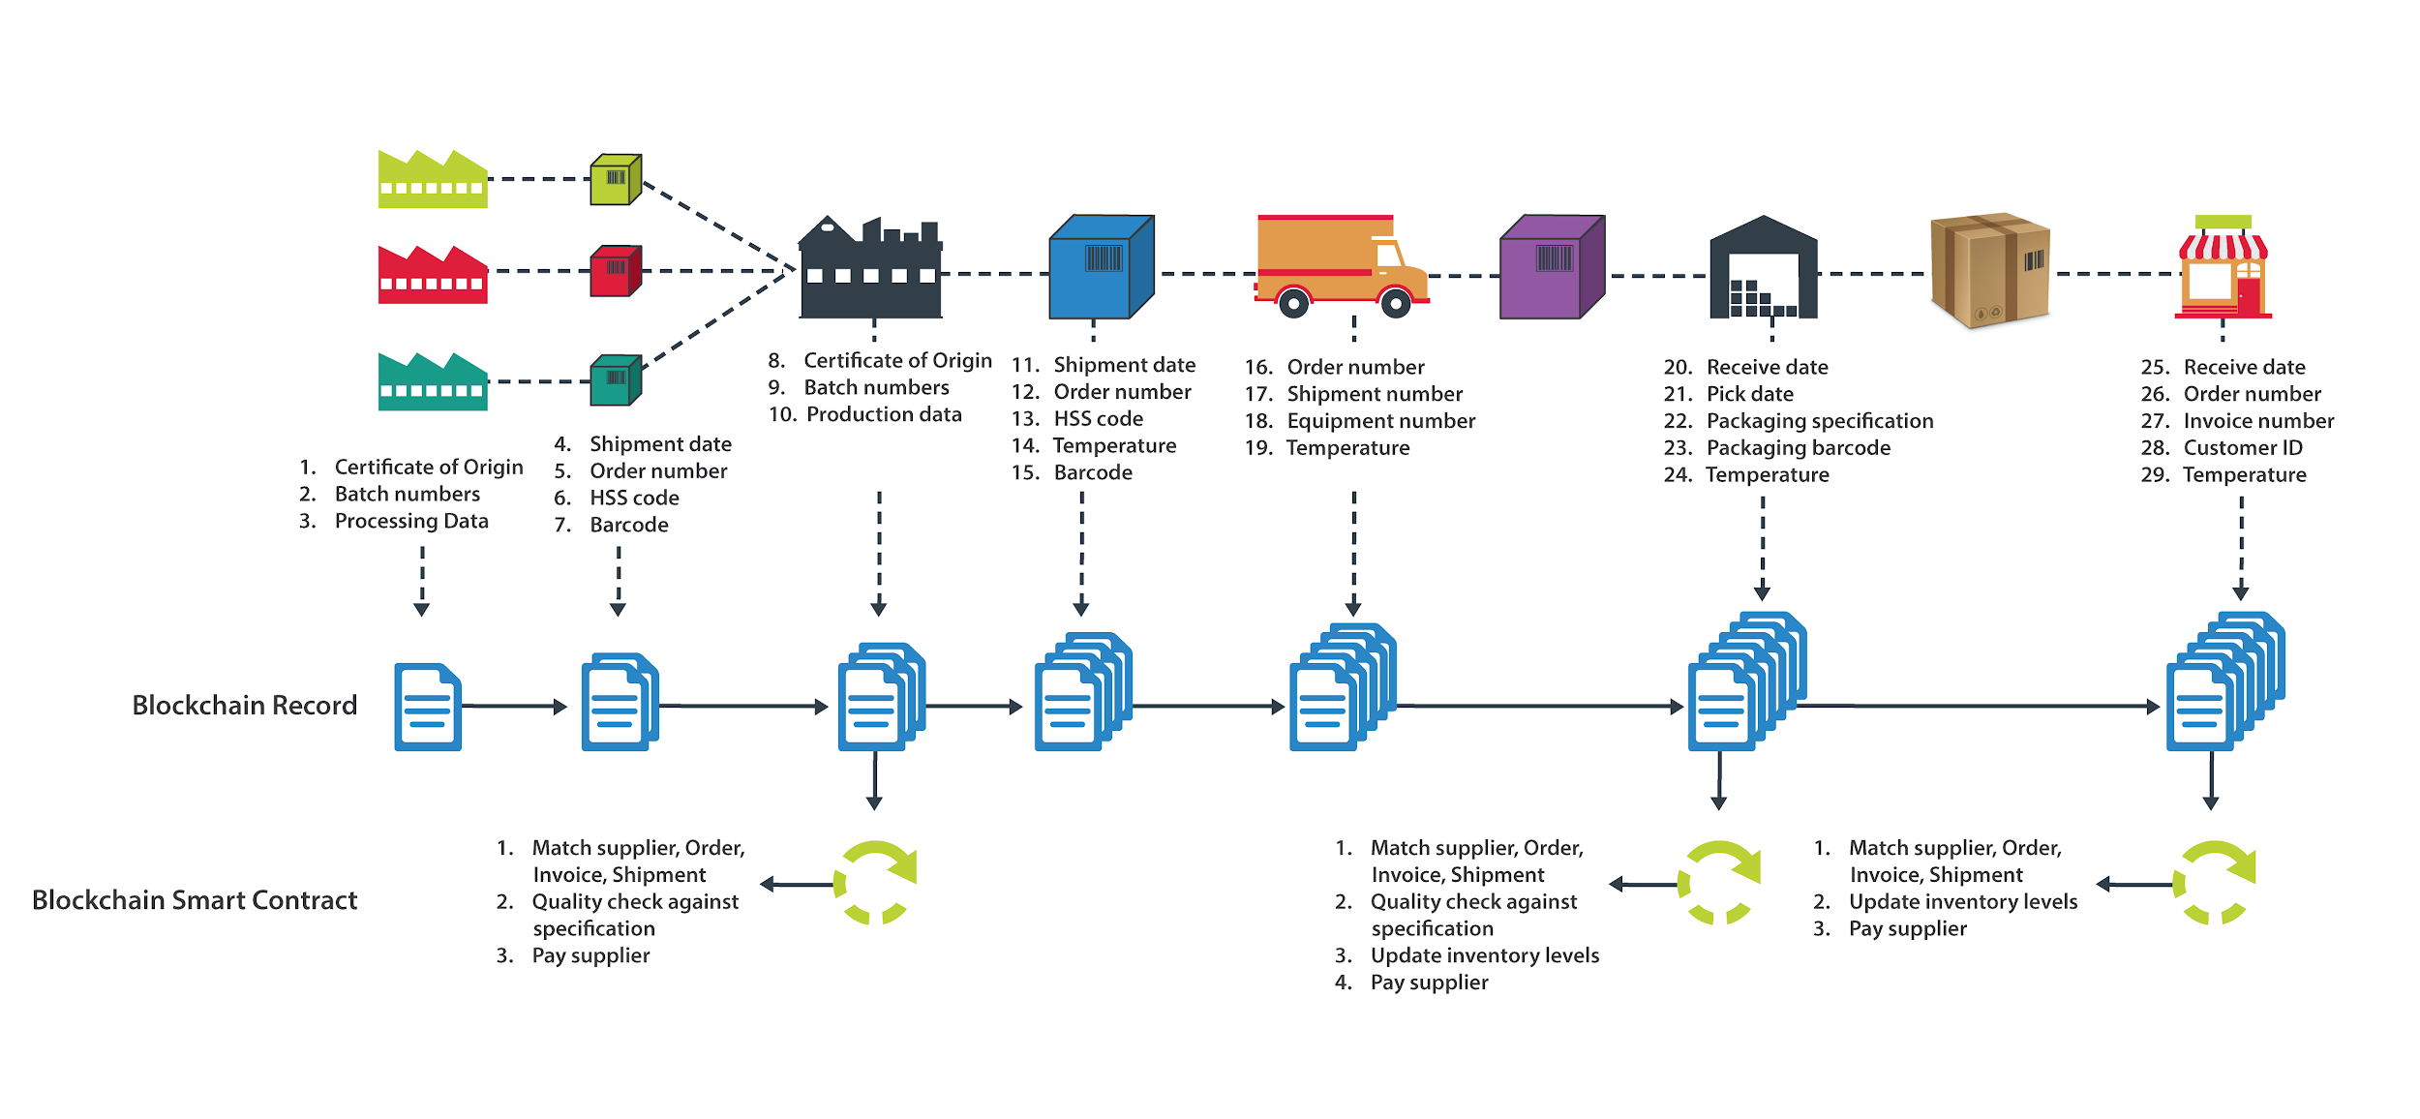
Supply Chain :

Slide 4
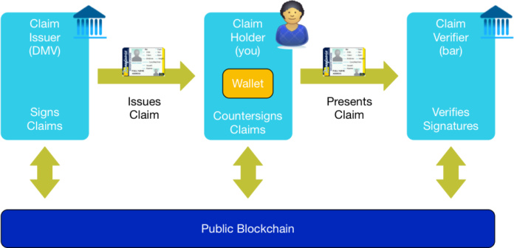
Self Sovereign Identity :

Slide 5
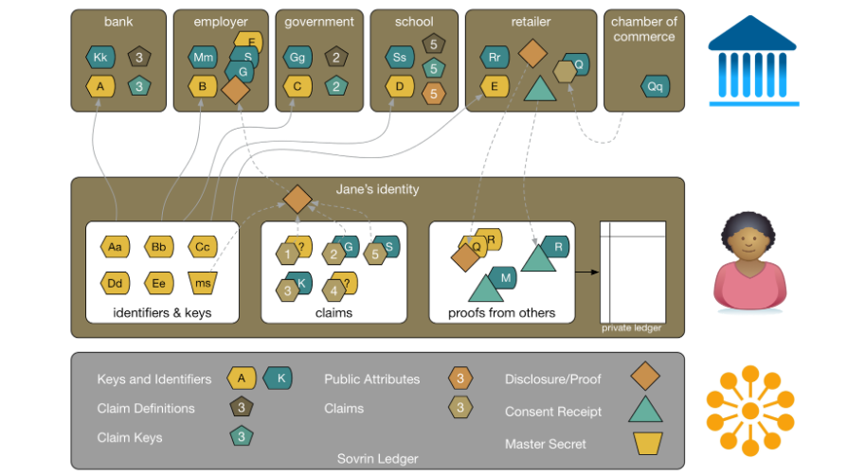
Self Sovereign Identity :

Slide 6
Self Sovereign Identity :
Lets see how DID actually works :
https://www.youtube.com/watch?time_continue=23&v=2XDGX41nr1o

Slide 7
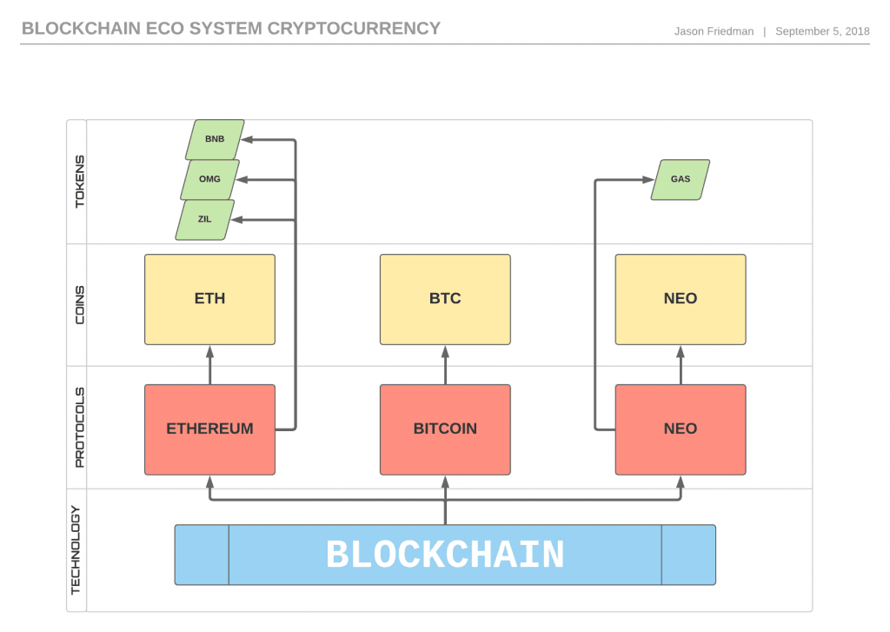
Tokens :
Notes:
Rewards/ Loyalty token

Slide 8
Tokens NFT Example on ICON:
All distinct and special
unique attributes and different value
Representive of real world entity into digital world!
Nepal Idol Example !

Slide 9
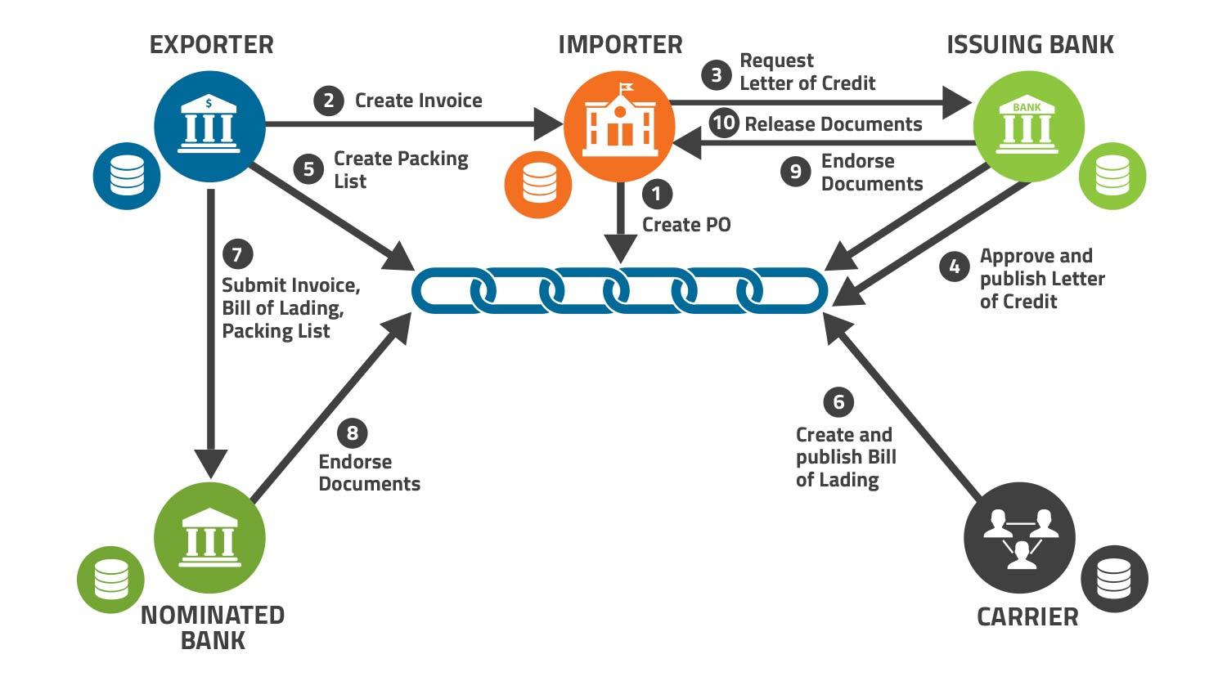
Trade Finance :

Slide 10
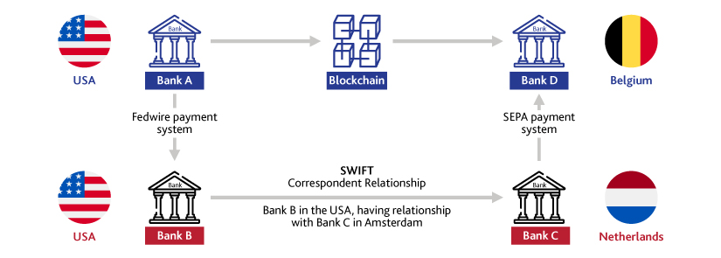
Remittance :

Slide 11
usecases contd :
AND Many more !!!!!
Healthcare
Insurance
Energy market
Voting

Slide 12
Blockchain Consensus Protocol:
Consensus : A dynamic way of reaching agreement in a group
Even if parties disagree, there is still overall consent to move forward in order to settle the issue.

Slide 13
Consensus contd.
In computer science consensus relates to problem of synchronizing state in distributed systems.
Reaching consensus : all participants eventually agree on a single system wide state.

Slide 14
Consensus contd.
Why do we need consensus mechanism in blockchain?
Let’s take bitcoin as an example
Around 10,000 nodes
No trusted central entity
Any node can create a block of transactions if miner able to solve the puzzle.
How can one node agree to the block of transactions created by another

Slide 15
Consensus contd.
Consensus defines a system of strict rules without defining the rulers !!
These rules allows all the participants to come to consensus and move forward with recording transactions.

Slide 16
Consensus contd.
Very difficult problem for open blockchain like Bitcoin and Ethereum
There could be bad actors trying to disrupt the system.
Well known computer science problem called “Byzantine Generals Problem”
https://www.youtube.com/watch?v=_MwqAaVweJ8

Slide 17
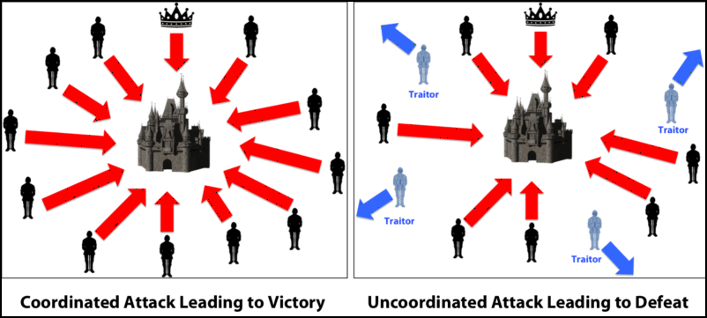
Consensus contd.
Byzantine Generals Problem
Courstery : Medium

Slide 18
Byzantine Generals Problem contd.
Very far apart so centralized authority is impossible
They can win is if they all attack at once.
Message can be compromised
Generals need, is a consensus mechanism
Bitcoin solved this problem in practice with its Proof Of Work
Since then other consensus mechanism has been tested and researched.

Slide 19
Types of Consensus
Proof Of Work (Bitcoin, Ethereum)
Proof Of Stake (Cosmos, Ethereum 2.0)
Delegated Proof of Stake (EOS)
Proof of Authority (Loom Network)
Delegated Proof of Contribution (ICON)

Slide 20
Proof Of Work
Most important invention underpinning Bitcoin.
Also known as “mining”
Primary purpose is to secure the blockchain.
To form a block of transactions, miners try to come up with a data with specific property.

Slide 21
Proof Of Work Contd.
Its a simple compute to try to come up with this data
But its costly and time consuming
Because its a random process with low probability.
For example Bitcoin uses Hashcash proof of work system

Slide 22
Proof Of Work Contd.
Its a simple compute to try to come up with this data
But its costly and time consuming
Because its a random process with low probability.
For example Bitcoin uses Hashcash proof of work system

Slide 23
Proof Of Work Contd.
In previous class we learned about Hashfunctions .
Output for any size input string is a 32 byte string output.
“A’ -> 87428fc522803d31065e7bce3cf03fe475096631e5e07bbd7a0fde60c4cf25c7
Which is a very large number --
61179838729486792668968979058053414913270730801205099111596190027298582242759

Slide 24
Proof Of Work Contd.
Bitcoin has something called a difficulty number -
https://bitcoinwisdom.com/bitcoin/difficulty
Miners have to take all the data in a block and add some random string to come up with a hash that is less than this difficulty number.
Its a probability game , more you try more chance you get the number.

Slide 25
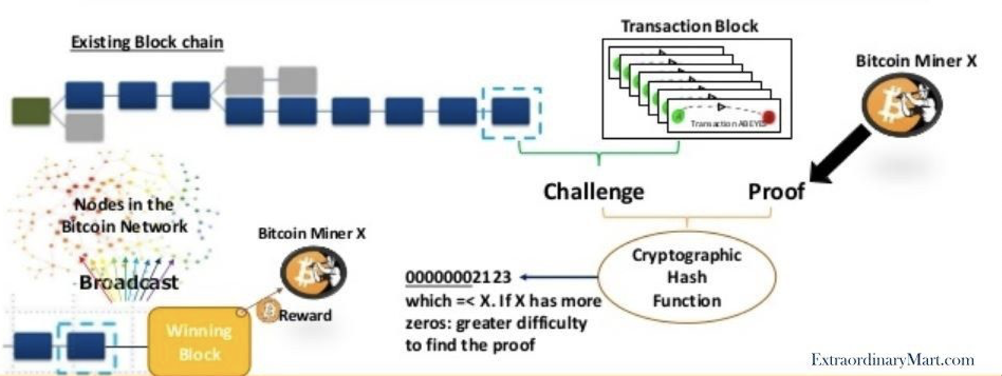
Proof Of Work Contd.

Slide 26
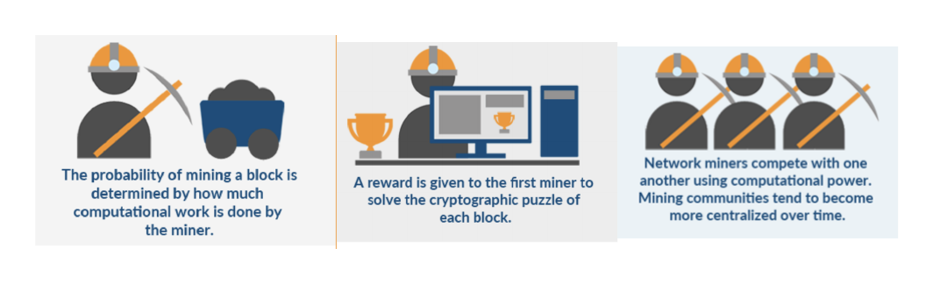
Proof Of Work Contd.

Slide 27
Proof Of Work Contd.
Advantages of POW:
Complete decentralization
Nodes are free to come in and out and are easy to implement
The cost of destroying the system is huge
Disadvantages of POW:
High demand on node performance, could lead to power play
Wastes energy but some look at it as good use of energy to secure a global hard money

Slide 28
Proof Of Stake
Older than Proof of Work
Tries to solve the same problem of reaching consensus in a distributed systems
Renewed interest in research because of high energy cost in POW.
Also now it is impossible to launch a POW network as possibility of 51% attack is high when hash rate is low.
Bitcoin was lucky as space was new and it got time to slowly ramp up.

Slide 29
Proof Of Stake Contd.
Key Features
Instead of miners , there are validators / block creators that create and validate the block.
Validators stake their wealth ( in the form of base token of the system) to indicate that they will maintain integrity
There is some sort of incentive for them to be honest.
Dishonest validators are punished
Cosmos is a good example of blockchain using POS.

Slide 30
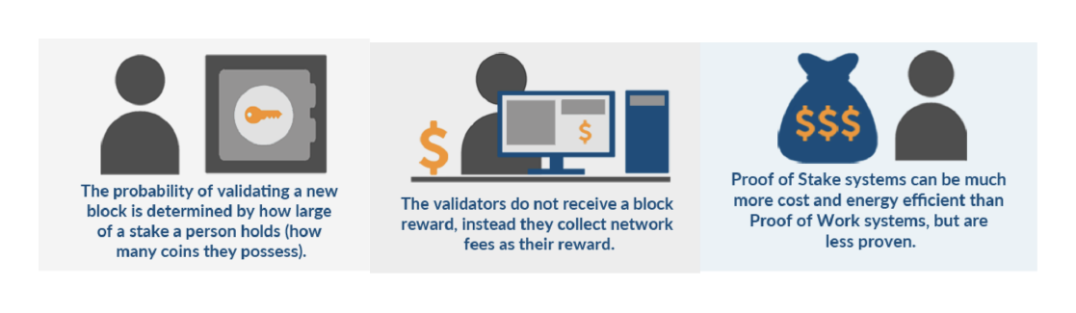
Proof Of Stake Contd.

Slide 31
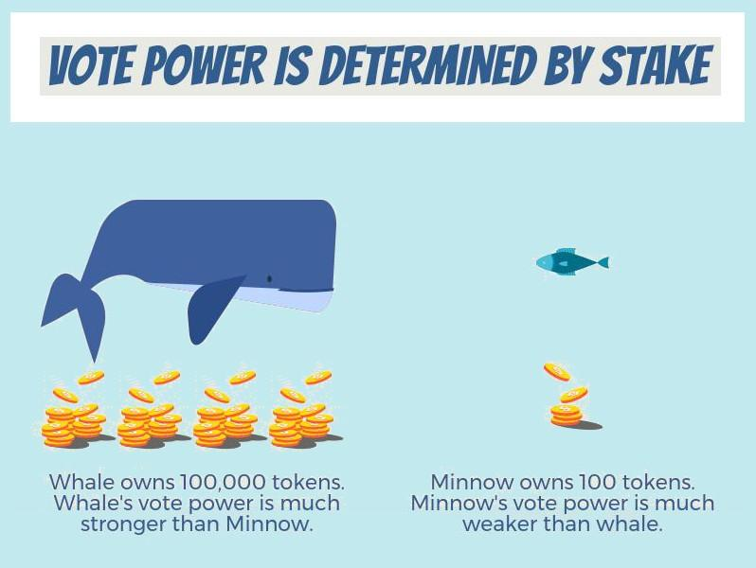
Proof Of Stake Contd.

Slide 32
Delegated Proof Of Stake
More efficient version of PoS
Uses a reputation system and real-time voting to achieve consensus
Community members votes for Witness Node selection by staking their token
Witness Node will be rewarded by validating transactions
Delegates (trusted parties responsible for maintaining the network)
Provision of down voting the validator
Democratic, self-governing community, open elections
27 Validator at TRON and 21 on the EOS, SteemIt

Slide 33
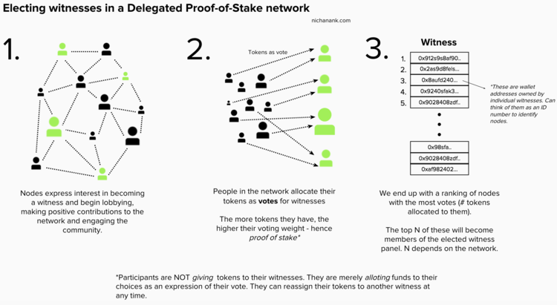
Delegated Proof Of Stake

Slide 34
Proof Of Authority
“It takes 20 years to build a reputation and five minutes to ruin it. If you think about that, you’ll do things differently.” — Warren Buffett

Slide 35
Proof Of Authority
Reputation-based consensus algorithm
Block validators are not staking coins but their own identity instead
Limited number of block validators
Highly scalable
Better for Private Blockchain and side chains
Conditions
valid and trustworthy identities
difficulty to become a validator
a standard for validator approval

Slide 36
Proof Of Authority contd.
Disadvantages:
Not Decentralized
Validators are visible
Used by POA.Network, Rinkeby and Kovan Ethereum Testnet.

Slide 37
Other conesus
Transaction As Proof Of Stake
Proof Of Capacity
Proof Of Elapsed Time
Proof of Delegated Contribution (ICON)

Slide 38
Bitcoin
Bitcoin the distributed, peer-to-peer system
Enables bitcoin - units of currency
Note the upper case and lower case - Network vs the currency
Together forms the digital money eco-system
bitcoin used to store and transmit value among participants in the bitcoin network.
bitcoin is entirely virtual. There is no physical coin

Slide 39
Bitcoin Contd.
Its a Rabbit Hole !!
Economics, game theory, mathmatics, computer science, cryptography
A decentralized peer-to-peer network (the bitcoin protocol)
A public transaction ledger (the blockchain)
Rules for transaction validation and currency issuance (consensus rules)
Mechanism to reach global consensus on what is valid

Slide 40
Bitcoin - History
Digitial currency before Bitcoin?
Yes , Hashcash, Bit Gold
They were all centralized
Easy to shutdown by government.
Honeypot for hackers

Slide 41
Bitcoin - History Contd.
Satoshi Nakamoto released white paper on 2008 titled “Bitcoin: A Peer-to-Peer Electronic Cash System”
Network launced in 2009.
First block - geneis block created on 2009-01-03
Satoshi Nakamoto withdrew from the public in April 2011
Second best thing Satoshi did after Bitcoin creation itself.
No single leader or figure head as it should be for a decentralized system.

Slide 42
How does it work (60,000 feet)?
Need to understand these entities first -
Private/Public Key : Cryptographic primitive.
Wallet : client application ( web, desktop , mobile app) that speaks the Bitcoin protocol to communicate with the network.
Address: wallet manages addresses to which one can send or receive bitcoin (think of it as bank account number)
Transaction : tells the network that the owner of some bitcoin value has authorized the transfer of that value to another owner
Mining: Create a block with validated transactions to record the transactions in the ledger.

Slide 43
Bitcoin Contd.
Private/Public Keys
Public key cryptography
Uses unique keys to secure information
A public-private key pair represents and secures an address
Bitcoin can be sent from and received in this address

Slide 44
Bitcoin Contd.
Wallet
Manages public-private key pair
Communicates with blockchain to send / receive bitcoin
Displays balance on an address it maintains (gets it from blockchain)
Think of it like gateway to the blockchain with easy UI for users to navigate this public-private key pair and transaction related to them on the blockchain

Slide 45
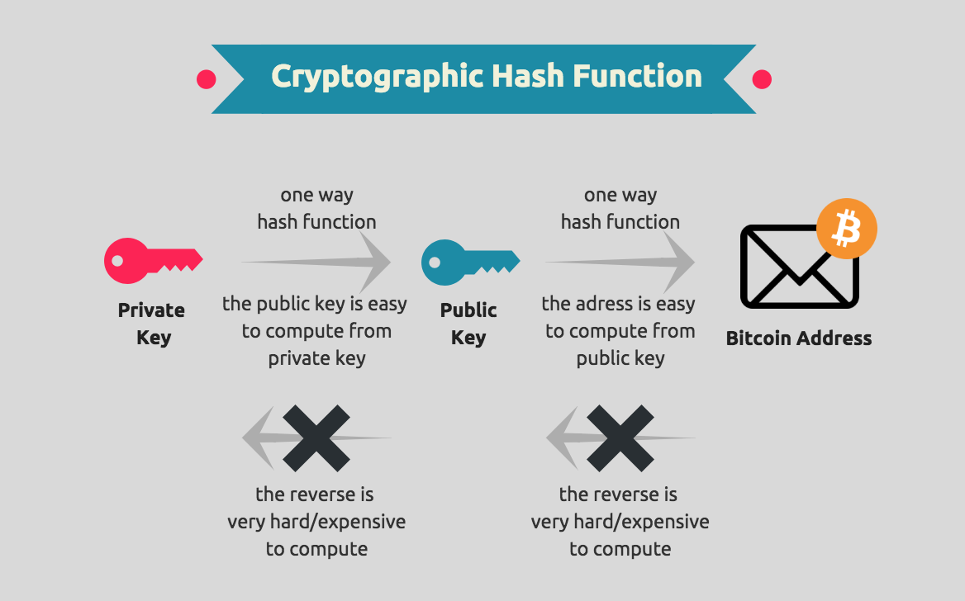
Bitcoin Contd.

Slide 46
Bitcoin Contd.
Address
Address is unique identifier generated from public key.
Bitcoin is sent and received from these addresses
Transaction
A transfer of bitcoin from one address to another (in its most simplest form)
Stored in one of the block in blockchain (or ledger)

Slide 47
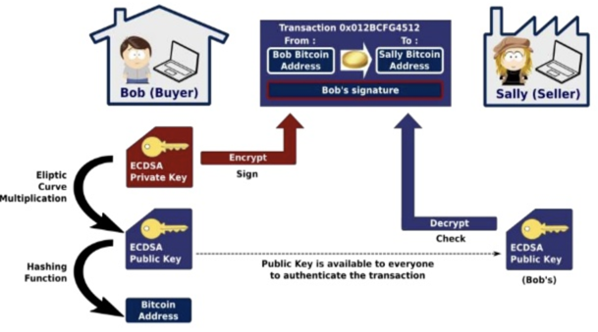
Bitcoin Contd.

Slide 48
Bitcoin Contd.
Mining
Mining is the mechanism by which bitcoin’s security is decentralized
Miners validate new transactions and record them on the global ledger
Global ledger == blockchain
Blockchain
Global ledger
Every node has a copy
HTC is planning a phone that can hold this ledger on a phone
Basis of -- “With Bitcoin you are your own Bank”

Slide 49
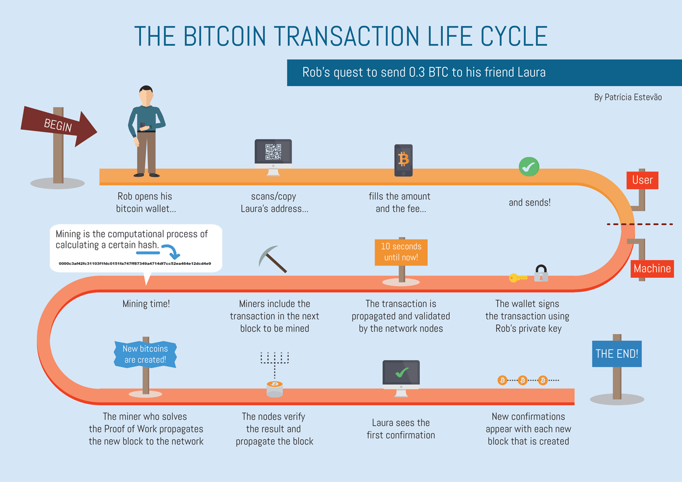
Bitcoin Contd.

Slide 50
Bitcoin Contd.
More details in next class!!!

Slide 51
Resources:
1.The bitcoin white paper
2. Proof of Work
3. Hashcash
4. Difficulty
5. Mastering Bitcoin
6. Proof Of Authority

